Slide 1




LAF - FPTU LOST AND FOUND
SUPERVISOR
Thầy Nguyễn Nguyên Bình
TEAM MEMBERS
Leader
Trần Thiên Quý
Trần Vĩnh Phát
Vũ Lâm Bảo Vân
Võ Quốc Việt
Phạm Nguyễn Hoài Linh

Slide 2







Table of content
2
Introduction
Our approaches
Demo
Outcomes

Slide 3


Table of content
3
Introduction
Our approaches
Demo
Outcomes

Slide 4

Introduction
4
What we do?

Slide 5






Introduction
5
Features
Manage Item Posting
Create Item Posting
Moderation Item Posting
1
2
3
View Item Posting
Search Item Posting
Sort Item Posting
4
5
6

Slide 6






Introduction
6
Architecture
Firebase Storage
USER
Web App | Heroku
Front-end Server | React
Rest API | NodeJS+Express
Database | mongoDB

Slide 7






Introduction
7
Core Workflow
ADMIN
Approve/Reject
USER
Create Lost&Found Item Posting
Login by FPT Email
Item Posting
Close Item post
Completed
Confirm by
other User
Comment
Check by
Serect Information

Slide 8
Table of content
8
Introduction
Our approaches
Demo
Outcomes

Slide 9


Table of content
9
Introduction
Our approaches
Demo
Outcomes

Slide 10
Our Approaches
10
Main Actors
USER
ADMIN

Slide 11






Our Approaches
11
ADMIN
Login
Comment on post
Logout
View list a post
ADMIN
Approve a post
View detail a post
Reject a post
Search post

Slide 12
Our Approaches
12
USER
Login
Comment on post
Logout
View list a post
USER
Create a post
View detail a post
Change status a post
Search post
Update post

Slide 13
Table of content
13
Introduction
Our approaches
Demo
Outcomes

Slide 14


Table of content
14
Introduction
Our approaches
Demo
Outcomes

Slide 15


Demo
15
Create Item Posting
USER
List of Item
Is listed to
Item posting
login
Item posting
Login by email
create
Validation
show on
Lost & Found Website
Item posting
Item posting
true
Item lost
Type
Identity Mask
Lost/Found date
Serect Information
Location
Contact Phone number
Image
…
view
false
Approve/ Reject
ADMIN

Slide 16
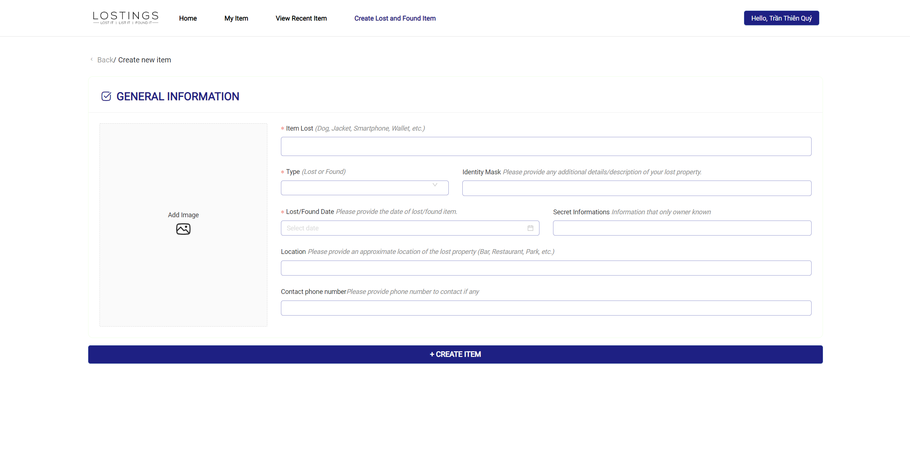
Demo
16
Create Item Posting

Slide 17

Demo
17
Search/Sort/Comment Item Posting
change
Change status
item posting
USER
search
Search item posting
login
sort
Sort item posting
(by Found/Lost status)
Login by email
view
Lost & Found Website
List of Item posting
Item posting
Comment
view
Item posting
Item posting
view
Item posting details
…

Slide 18
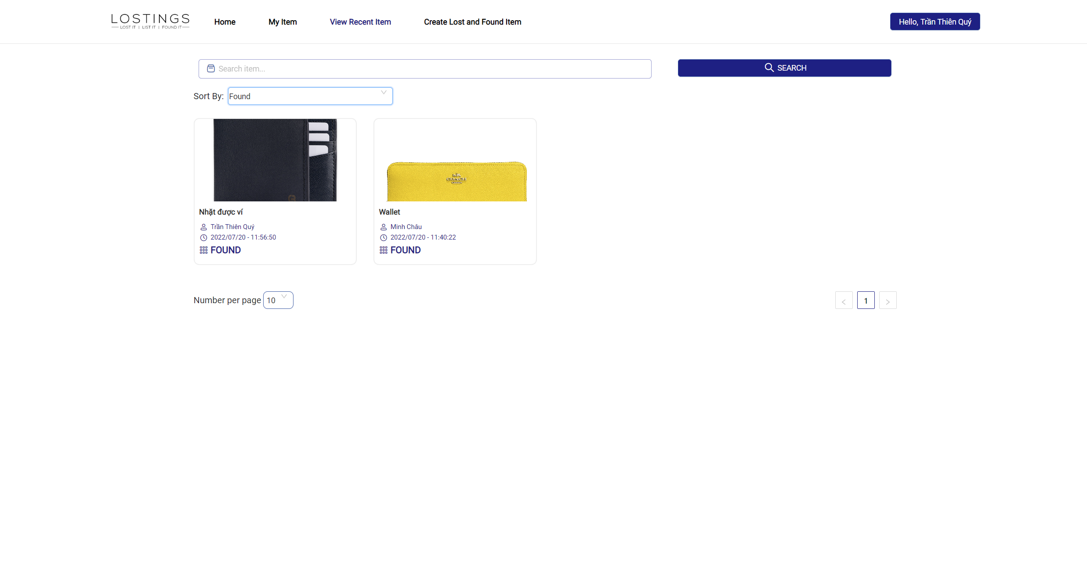
Demo
18
Search/Sort/Comment Item Posting

Slide 19
Demo
19
Morderation Item Posting
search
Search item posting
ADMIN
show on
sort
Sort item posting
(by Found/Lost status)
login
Login by User & Password
view
Lost & Found Website
view
List of Item posting
View waiting approval
item posting
Item posting
Comment
view
Item posting
List of waiting approval Item posting
Item posting
view
Item posting details
Item posting
…
Item posting
Moderation
Item posting
Approve/Deny
…

Slide 20
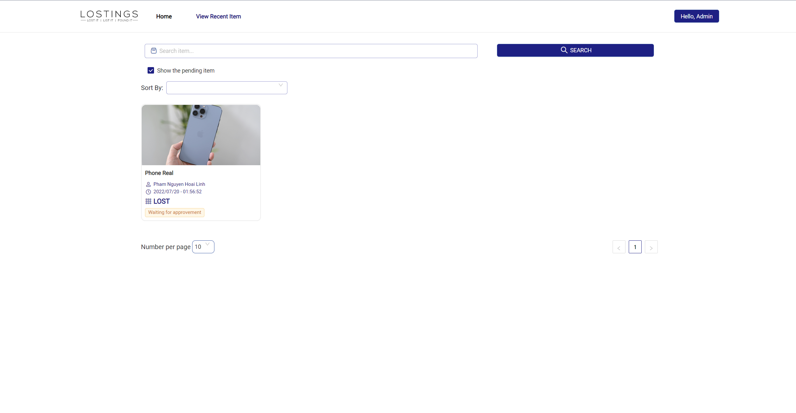
Demo
20
Morderation Item Posting

Slide 21
Table of content
21
Introduction
Our approaches
Demo
Outcomes

Slide 22


Table of content
22
Introduction
Our approaches
Demo
Outcomes

Slide 23




Outcomes
23
Future Plan
Report daily
Manage User
Notification
Send Text Message
Mobile App
Notes:
Noti, Mobile app,
Manage user, send text message

Slide 24
Q&A

Slide 25
THANK YOU!

